Slide 1

Java 12 New Features
Dima Ionut Daniel

Slide 2
Contents
What is Java?
History
Java Flavors
New Features
Core
Other Improvements
Bibliography

Slide 3

What is Java?
Java is a programming language created by Sun Microsystems.
Java is used in a wide variety of computing platforms from embedded devices and mobile phones on the low end, to enterprise servers and supercomputers on the high end.
Memory management is handled through integrated automatic garbage collection performed by the JVM.
The heart of the Java platform is the concept of a "virtual machine" that executes Java bytecode programs. This bytecode is the same no matter what hardware or operating system the program is running under.
There is a JIT(Just-In-Time) compiler within the Java Virtual Machine, or JVM. The JIT compiler translates the Java bytecode into native processor instructions at run-time and caches the native code in memory during execution.
The Java programs are cross-platform or platform independent, but the code of the Java Virtual Machines (JVM) that execute these programs is not.

Slide 4
History
The initial Java release was named Oak, and the first stable version was JDK 1.0.2, called Java 1.
JDK 1.0 - 23 January 1996
JDK 1.1 – 19 February 1997
J2SE 1.2 – 8 December 1998 (codename Playground)
J2SE 1.3 – 8 May 2000 (codename Kestrel)
J2SE 1.4 – 6 February 2002 (codename Merlin)
J2SE 5.0 – 30 September 2004 (codename Tiger)
Java SE 6 – 11 December 2006 (codename Mustang)
Java SE 7 – 7 July 2011(codename Dolphin)
Java SE 8 – 18 March 2014 (codename Spider)
Java SE 9 – 21 September 2017
Java SE 10 – 20 March 2018
Java SE 11 – 25 September 2018
Java SE 12 – 19 March 2019

Slide 5
Java Flavors
The Java distribution comes in different flavors:
Java Card →run securely on smart cards and similar small-memory devices.
Java ME(Micro Edition) → Specifies several different sets of libraries (known as profiles) for devices with limited storage, display, and power capacities.
Java SE(Standard Edition) → for general-purpose use on desktop PCs, servers and similar devices.
Java EE(Enterprise Edition) → Java SE plus various APIs useful for multi-tier client–server enterprise applications.

Slide 6
New Features
JEP 325 - Switch Expressions
JEP 326 - Raw String Literals
JEP 189 -Shenandoah: A Low-Pause-Time Garbage Collector (Experimental)
JEP 230 - Microbenchmark Suite
JEP 334 - JVM Constants API
JEP 340 - One AArch64 Port, Not Two
JEP 341 - Default CDS Archives
JEP 344 - Abortable Mixed Collections for G1
JEP 346 - Promptly Return Unused Committed Memory from G1

Slide 7
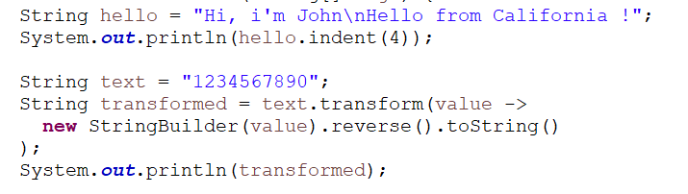
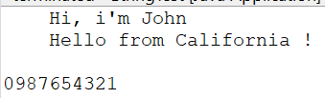
Core
Java 12 comes with two new methods in the String class: indent and transform.
The indent method adjusts the indentation of each line based on the integer parameter.
The second new method is transform. It accepts a single argument function as a parameter that will be applied to the string.

Slide 8
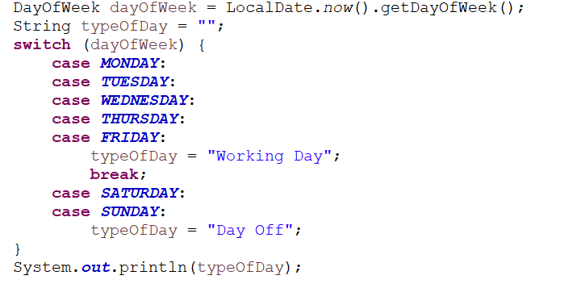
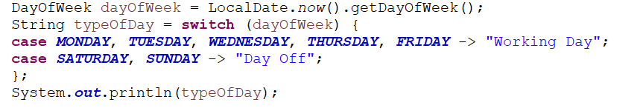
Core (cont.)
The most popular feature introduced in Java 12 is the Switch Expressions. New switch statements are more compact and readable. They also remove the need for break statements. Another notable difference is that we can assign a switch statement directly to the variable. It was not possible previously. Old syntax:
New syntax:

Slide 9
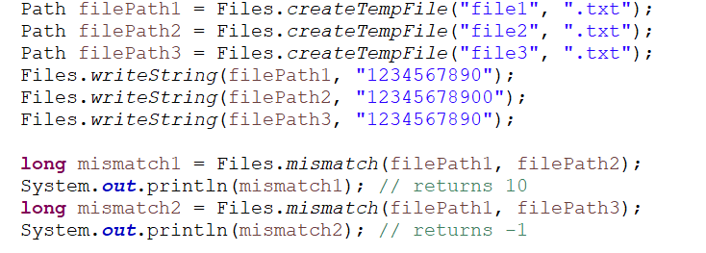
Core (cont.)
A new mismatch method is introduced into the nio.file.Files utility class.
The method is used to compare two files and find the position of the first mismatched byte in their contents. The return value will be in the inclusive range of 0L up to the byte size of the smaller file or -1L if the files are identical.

Slide 10
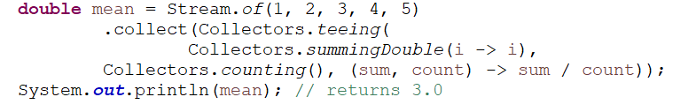
Core (cont.)
A new teeing collector was introduced as an addition to the Collectors class.
It is a composite of two downstream collectors. Every element is processed by both downstream collectors. Then their results are passed to the merge function and transformed into the result.

Slide 11
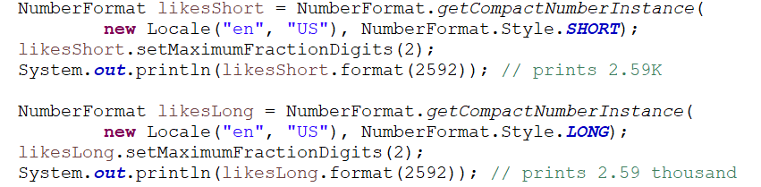
Core (cont.)
We have a new number formatter class CompactNumberFormat. It’s designed to represent a number in a shorter form, based on the patterns provided by a given locale. We can get its instance via the getCompactNumberInstance method in NumberFormat class.

Slide 12
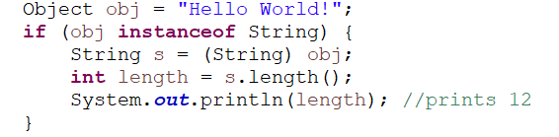
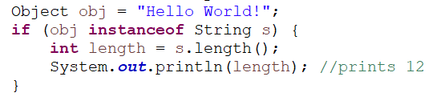
Core (cont.)
A new nice features introduces was the pattern matching for instanceof.
The compiler will automatically inject the typecasted String s variable for us.
Old Syntax:
New Syntax:

Slide 13
Other Improvements
Java 12 introduces a suite of around 100 microbenchmark tests to the JDK source code.
These tests will allow for continuous performance testing on a JVM.
This will become useful for every developer wishing to work on the JVM itself or create a new microbenchmark.

Slide 14
Other Improvements (cont.)
Shenandoah is an experimental garbage collection (GC) algorithm initiated by RedHat, for now not included in the default Java 12 builds.
It reduces the GC pause times by doing evacuation work simultaneously with the running Java threads.
With Shenandoah, pause times are not dependent on the heap’s size and should be consistent.

Slide 15
Other Improvements (cont.)
Stating Java 12, G1 will now check Java Heap memory during inactivity of application and return it to the operating system. This is a preemptive measure to conserve and use free memory.
Improvements in G1 efficiency include making G1 mixed collections abortable if they might exceed the defined pause target. This is done by splitting the mixed collection set into mandatory and optional.

Slide 16
Other Improvements (cont.)
The Z Garbage Collector now supports class unloading.
By unloading unused classes, data structures related to these classes can be freed, lowering the overall footprint of the application.
Class unloading in ZGC happens concurrently, without stopping the execution of Java application threads, and has thus zero impact on GC pause times. This feature is enabled by default but can be disabled using the command line option -XX:-ClassUnloading.

Slide 17
Other Improvements (cont.)
The Class Data Sharing (CDS) feature helps reduce the startup time and memory footprint between multiple Java Virtual Machines.
It uses a built-time generated default class list that contains the selected core library classes.
The change that came with Java 12 is that the CDS archive is enabled by default.
To run programs with CDS turned off we need to set the Xshare flag to off (java -Xshare:off HelloWorld.java).

Slide 18
Other Improvements (cont.)
The new package java.lang.invoke.constant introduces an API to model nominal descriptions of class file and run-time artifacts, in particular constants that are loadable from the constant pool.
It does so by defining a family of value-based symbolic reference (JVMS 5.1) types, capable of describing each kind of loadable constant.
A symbolic reference describes a loadable constant in purely nominal form, separate from class loading or accessibility context.

Slide 19

Bibliography
http://en.wikipedia.org/wiki/Java_(programming_language)
Learn Java 12 Programming
https://www.baeldung.com/java-12-new-features
https://www.digitalocean.com/community/tutorials/java-12-features
https://www.oracle.com/java/technologies/javase/12-relnote-issues.html

